Slide 1






🌿 EcoTrack
Smart Garbage Management System
"Right pickup, at the right place, at the right time."
TEAM VAMOS
CHINMAY APEKSHA SUBRAMANYA OMKAR

Slide 2
Problem Statement
❌
🔕
🛣️
🗑️
📵
Missed
Pickups
No Arrival
Alerts
Inefficient
Routes
Illegal
Dumping
No
Accountability
Impact: Unhygienic environments, poor city cleanliness & inefficient municipal operations.
Waste Generation by City Tier (Tons/Day)
150K+
Tons/day India
25%
Missed pickup rate
₹22.5L
Monthly loss/city

Slide 3
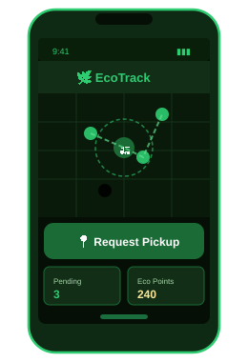
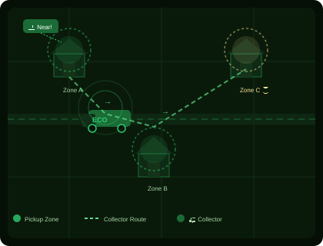
Solution Overview
RESIDENT
Request pickup via app
Notified when collector arrives
Mark garbage on map
Confirm pickup done
Earn Eco Points
🚛 COLLECTOR — Live Geofencing Map
📡 How Geo-Fencing Works
Resident
Pins Location
Truck Enters
Geo-Zone
Auto
Notification
Resident
Ready
Pickup
Confirmed ✅
→
→
→
→

Slide 4
Target Market & Market Analysis
🏠 Urban Residents
🚛 Garbage Collectors
🏛️ Municipal Corps
Apartments & gated
communities needing
reliable pickup
Municipal workers needing
optimized, demand-
based routing
City authorities needing
accountability &
analytics dashboards
📊 Market Share by City Type
Market Scope
🏙️ Smart city initiatives rapidly expanding
📱 Rising smartphone use among workers
🇮🇳 Swachh Bharat + Digital India push
📈 Tier 1→ optimize | Tier 2/3→ digitize
🤝 Municipal partnership-ready model

Slide 5
Tech Stack
📱
Frontend / Mobile
🖥️
Backend
🗄️
Database
React Native | Flutter
Node.js | Express.js
Firebase Firestore | MongoDB
🗺️
Geo-Location
🔔
Push Notifications
📊
Analytics / Admin
Leaflet | Geofencing SDK
Firebase Cloud Messaging
React Dashboard | Chart.js

Slide 6
Implementation Approach
1
2
3
4
5
📲 Resident
Requests Pickup
→
📡 Geofence
Detects Arrival
→
🗺️ Collector Gets
Live Route
→
🔄 Forced Status
Update
→
📊 Admin Gets
Analytics
✅ Feasibility & Viability
💰 No Hardware
☁️ Cloud Scalable
📶 Low Bandwidth
Existing smartphones only. Zero infrastructure.
Firebase scales 1 zone → 1000+ cities.
Designed for Tier 2/3 low-data environments.
🎓 Minimal Training
🤝 Municipal Model
🔒 Proven Stack
Ultra-simple UI for collectors.
Pilot → prove KPIs → expand via contracts.
FCM, Maps API, Firebase: production-proven.

Slide 7
Market Potential & Cost Advantage
150K+
4,000+
₹3,000Cr
Tons waste/day
Cities semi-manual
Annual waste budget
💰 Cost Comparison — Without vs With EcoTrack (₹/day)
✅ Cost Advantages
📵 No sensors / hardware
📱 Uses existing phones
☁️ Pay-as-you-scale cloud
⛽ 20–30% fuel savings
📉 70% missed pickup cost drop
💵 ₹16.2L saved/city/month

Slide 8
Financial Impact
📉 Missed Pickup Analysis
Scenario
Missed Rate
Daily Cost (1000 homes)
❌ Without EcoTrack
20% – 30%
₹75,000 / day
✅ With EcoTrack
5% – 8%
₹21,000 / day
🚀 Monthly Savings
60–75% drop
₹16,20,000 / month
📊 Projected Monthly Savings Growth (₹ Lakhs)
🚛 Fuel & Time Savings
⛽ 20–30% fuel cost reduction
⏱️ More areas covered — same crew
💵 ₹3,000–₹4,500 saved/truck/month

Slide 9
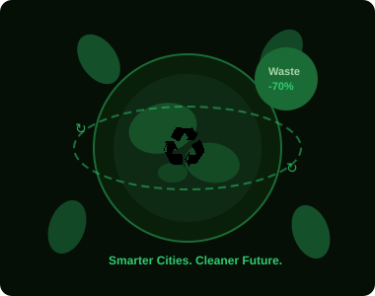
Outcomes & KPIs
📉
✅
♻️
Missed Pickups
Successful Collections
Eco Points Engagement
↓ 60–75%
↑ 40%+
↑ Active
🚛
🌿
💰
Collector Movement
Cleaner Streets
Monthly Savings
↓ 30%
↓ Dumps
₹16.2L
📊 Efficiency Improvement with EcoTrack (%)

Slide 10
Competitive Advantage & Pitch
✔ Focus on coordination, not just tracking
✔ Behavior-driven: forced updates + reward system
✔ Zero hardware dependency — pure software solution
✔ Designed for real-world Indian city usability
✔ Admin dashboard for strategic city-level planning
Adoption Strategy
🎁 Incentivize residents using Eco Points
📱 Collector app: minimal UI, large buttons, offline-first
🏛️ Pilot one municipal zone → prove KPIs → expand city-wide
"EcoTrack transforms waste collection from a blind, manual process into a smart, coordinated, and accountable system — improving efficiency, reducing waste, and making cities cleaner."

